Slide 1
Machine Learning Models to Predict Student Performance
Nash Balraj
21 October 2024

Slide 2
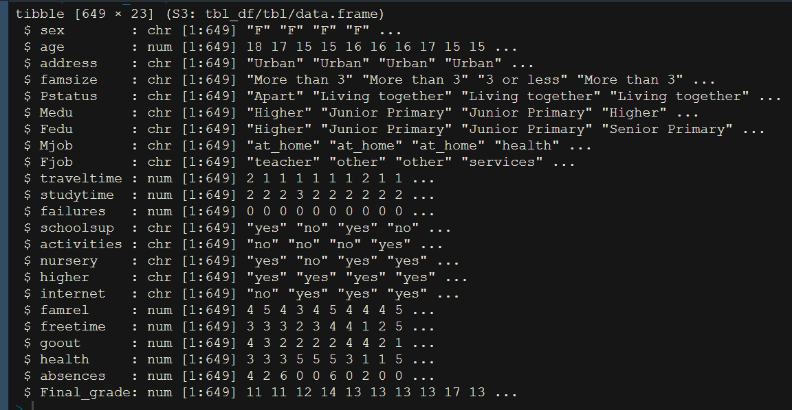
Introduction to the Dataset
Target Variable is Final Grade
23 Attributes & 649 Observations
Non-Linear relationship
High dimensionality
Small Inconsistencies
Medium Size & Complex Dataset

Slide 3
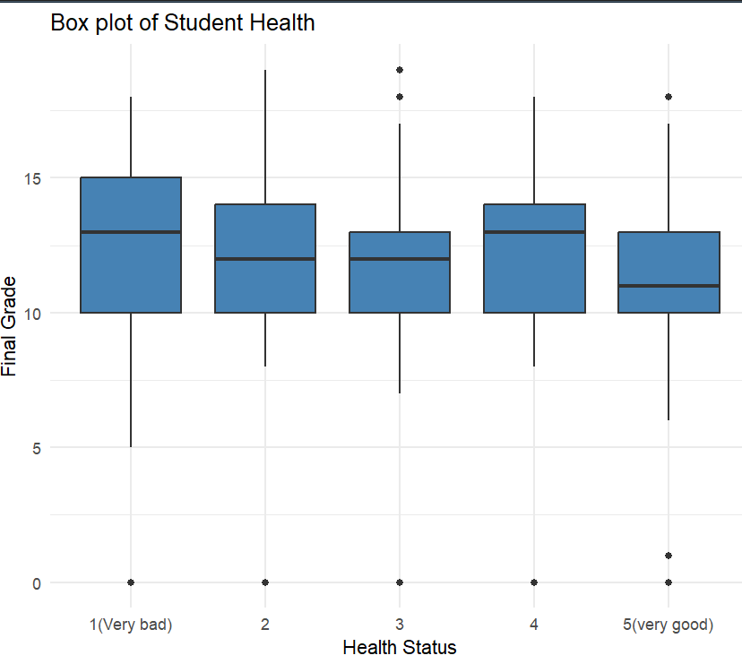
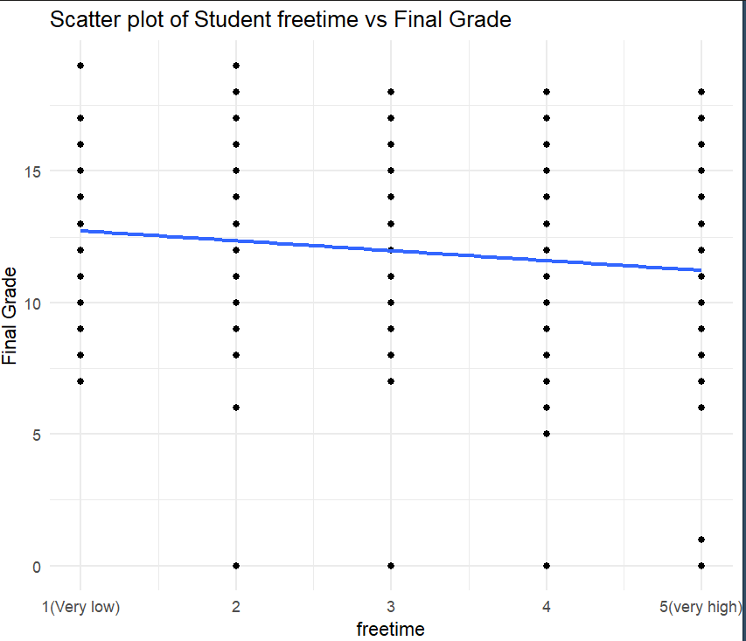
Complexity of Dataset

Slide 4
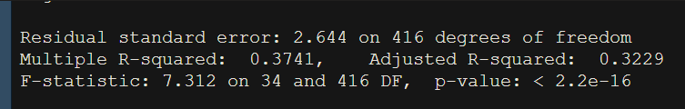
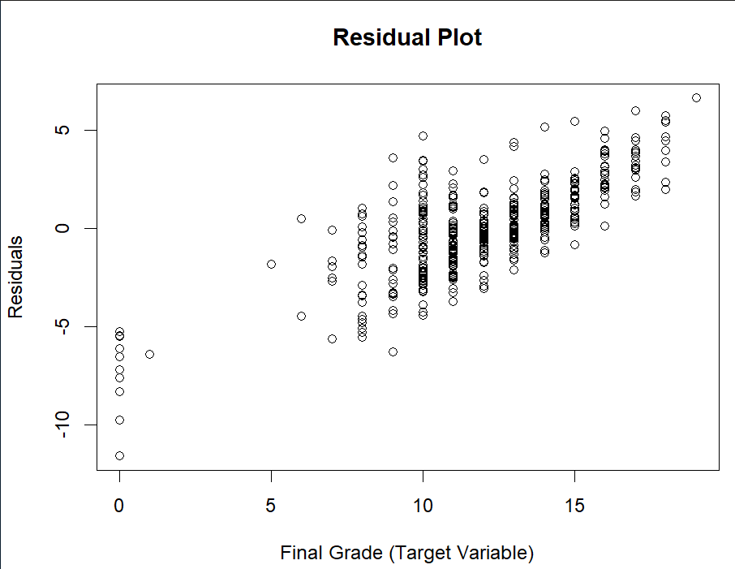
Linear or Non-Linear Relationship
Fitted OLS Model
R-squared(0.37421)
High bias,resulting in undefitting
Strong Non-Linear relationship
Residual plot clusters & patterns
Regularisation Methods not Ideal

Slide 5
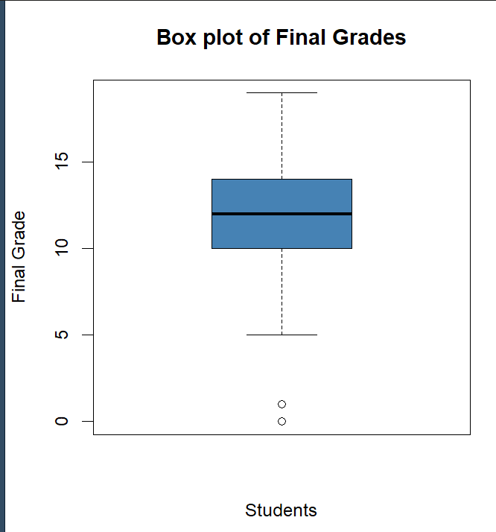
Distribution of Target Variable(Final Grade)
standard deviation (3.2)
mean (11.91) and median (12)
Q1:25% of students scored below 10 points
Q3:75% of students scored below 14 points
Min (0) and Max (19)
2 points of prediction error is acceptable

Slide 6
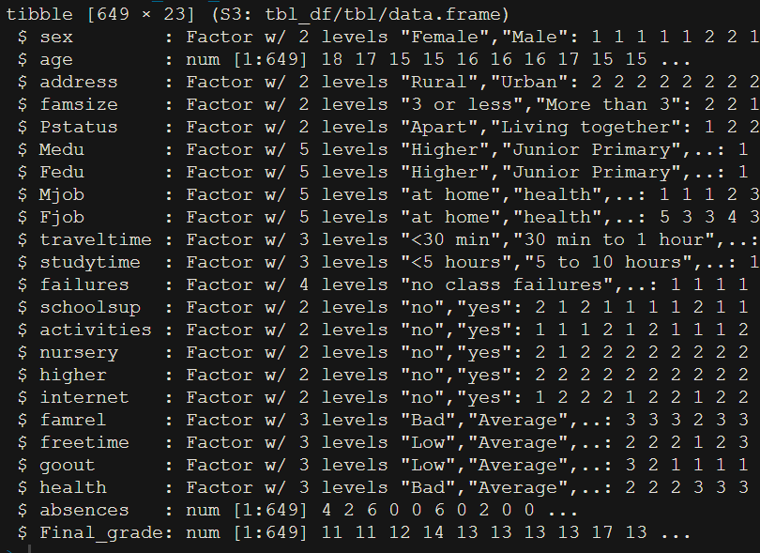
Data Preprocessing & Preparation
No missing values
Convert categorical attributes into factors
Converting numerical attributes into factors
Reduce the factor levels
m →Male and f→Female
at_home → at home

Slide 7
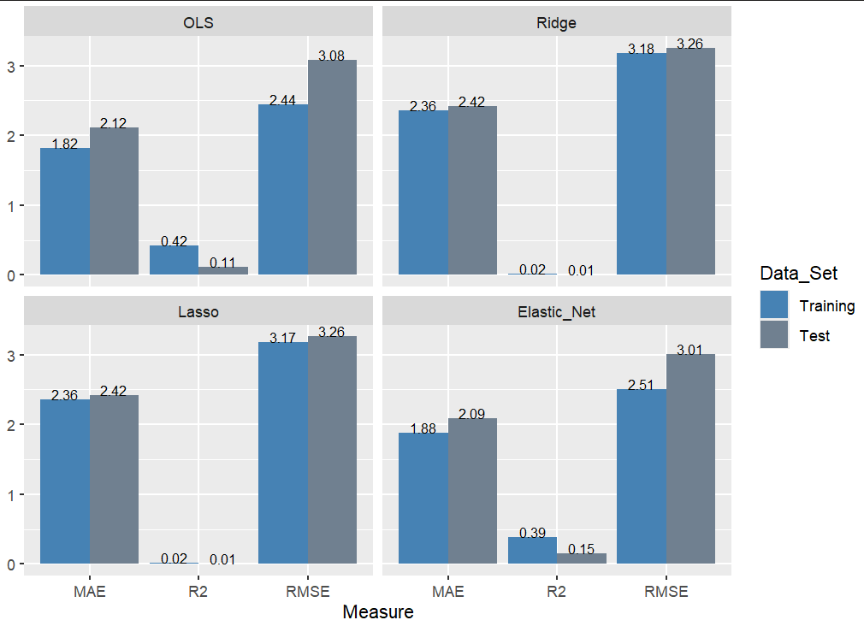
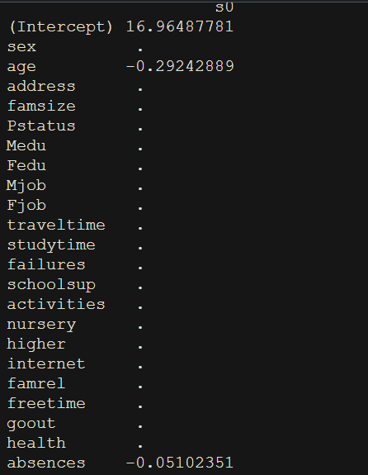
OLS, Ridge, Lasso, and Elastic Net Regression Models
70-30 split
Zeroed parameter estimates

Slide 8
Regression Tree & Pruning
10 Fold for Cross Validation
10 Terminal Nodes
Root Node → Failures indicate struggles in academic performance
Absences
Mothers's job
Mother's Education
Study time

Slide 9
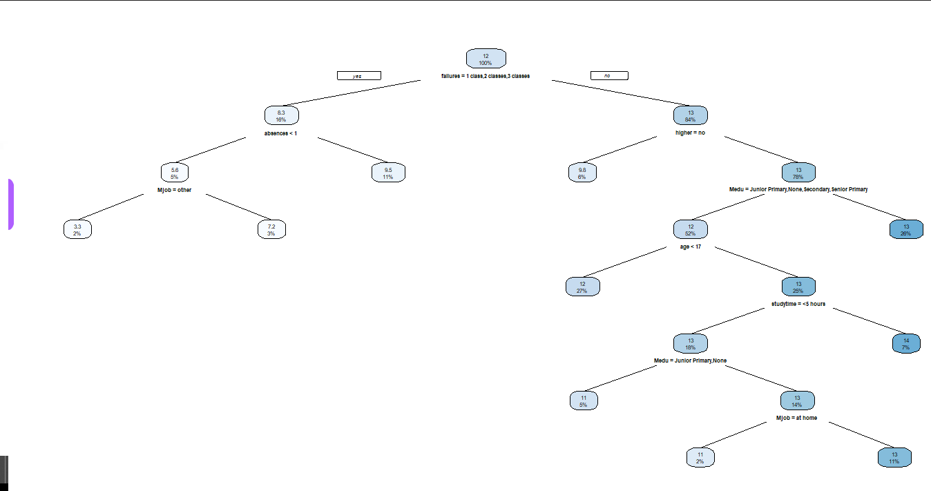

Slide 10
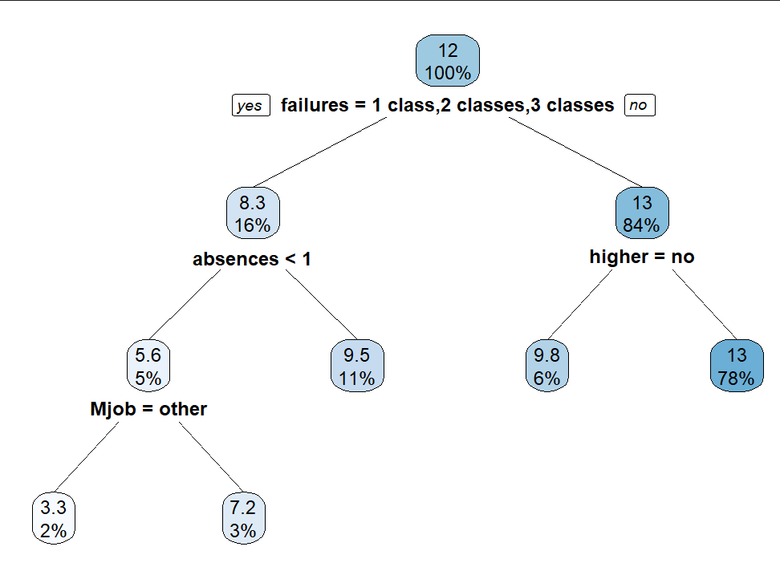
Pruned Regression Tree
cp(0.01739184)
5 Terminal Nodes
Root Node → failures
Absences
Mothers's job
Desire to Pursue Higher Education

Slide 11
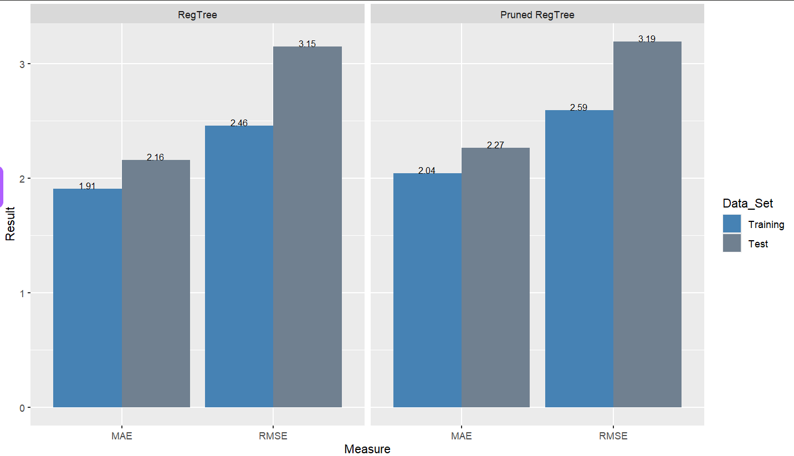
Evaluate Regression Trees

Slide 12
Support Vector Regression
Epsilon (0.5)
Good balance between model complexity and accuracy
Improving generalization to unseen data
Tolerant to outliers
402 Support Vectors

Slide 13
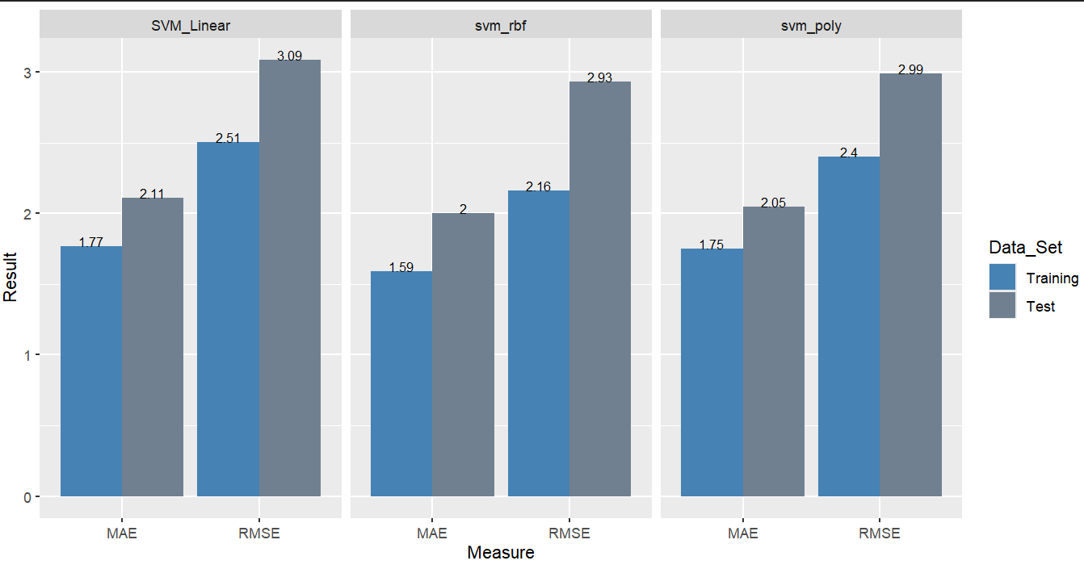

Slide 14
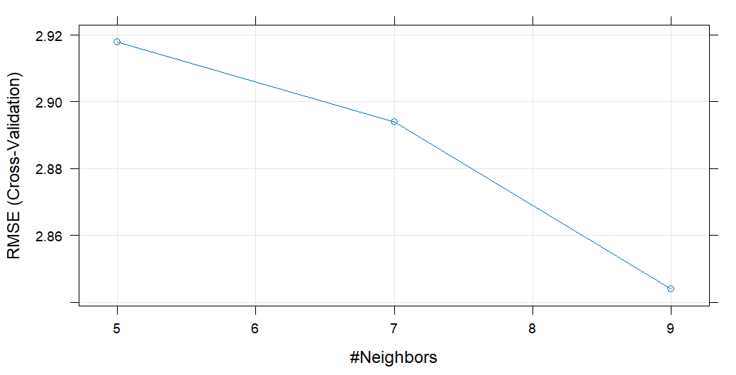
K-Nearest Neighbors (KNN)

Slide 15
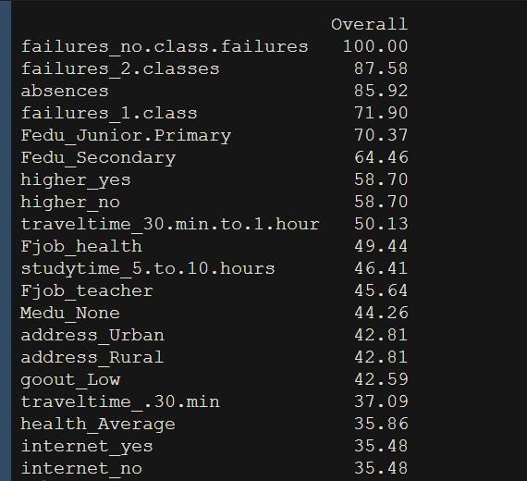
Neural Network

Slide 16
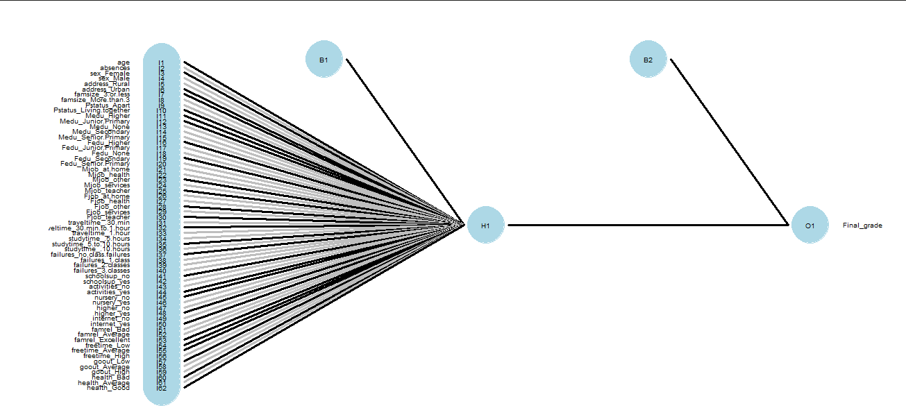

Slide 17
Model Comparison & Best Performing Model
Non-parametric Models
Support Vector Machine (SVM) with a Radial Basis Function (RBF) kernel
2-point threshold
Lowest MAE for both training and test sets
Good generalization with no significant overfitting or underfitting
SVM_RBF can handle more complex, non-linear boundaries

Slide 18
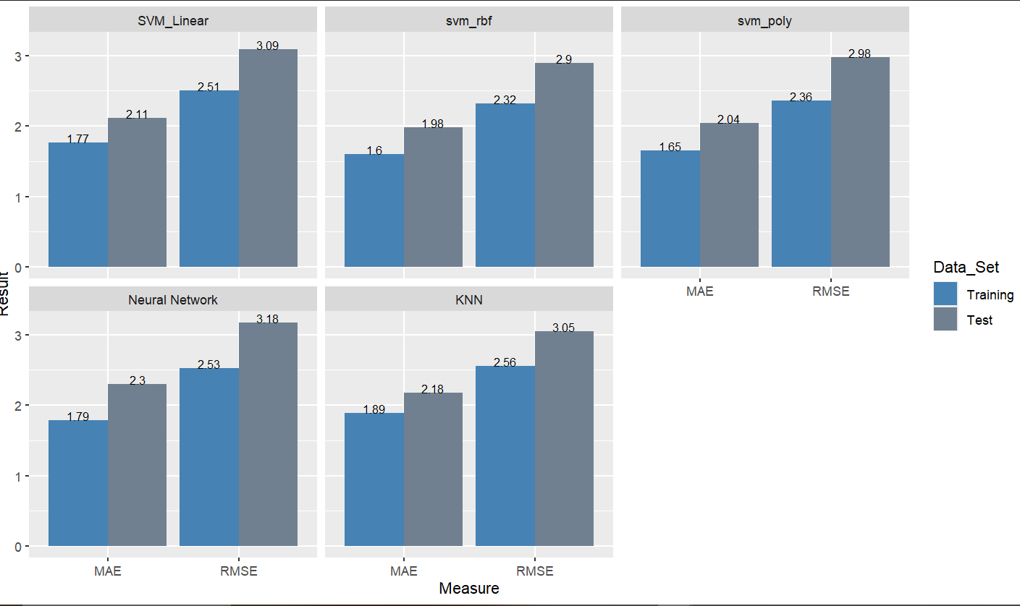

Slide 19
Thank you

